Slide 1
AIR CONDITIONING · CHAPTER 1
1.3 Vapor Compression Cycle
1
2
Latent heat, four components, P-h diagram, and COP
1.3
Follow the refrigerant to see how an air conditioner moves heat from indoors to outdoors.
Latent heat
Compressor
3
4
P-h diagram
COP
Concept-first slides with teaching detail in the card
Air Conditioning · Chapter 1 · Topic 1.3
1

Slide 2
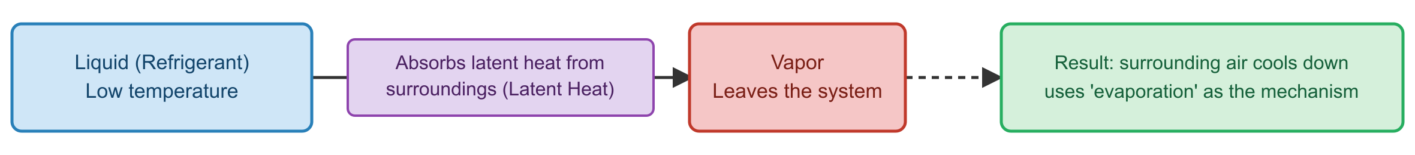
Refrigeration starts with latent heat
2
Phase change absorbs or releases heat at nearly constant temperature.
CORE IDEA
Cooling is boiling in the right place
Evaporation
1
liquid → vapor absorbs heat indoors
Condensation
2
vapor → liquid releases heat outdoors
Pressure sets temperature
3
engineer controls boiling point
Latent heat during phase change
Air Conditioning · Chapter 1 · Topic 1.3
2

Slide 3
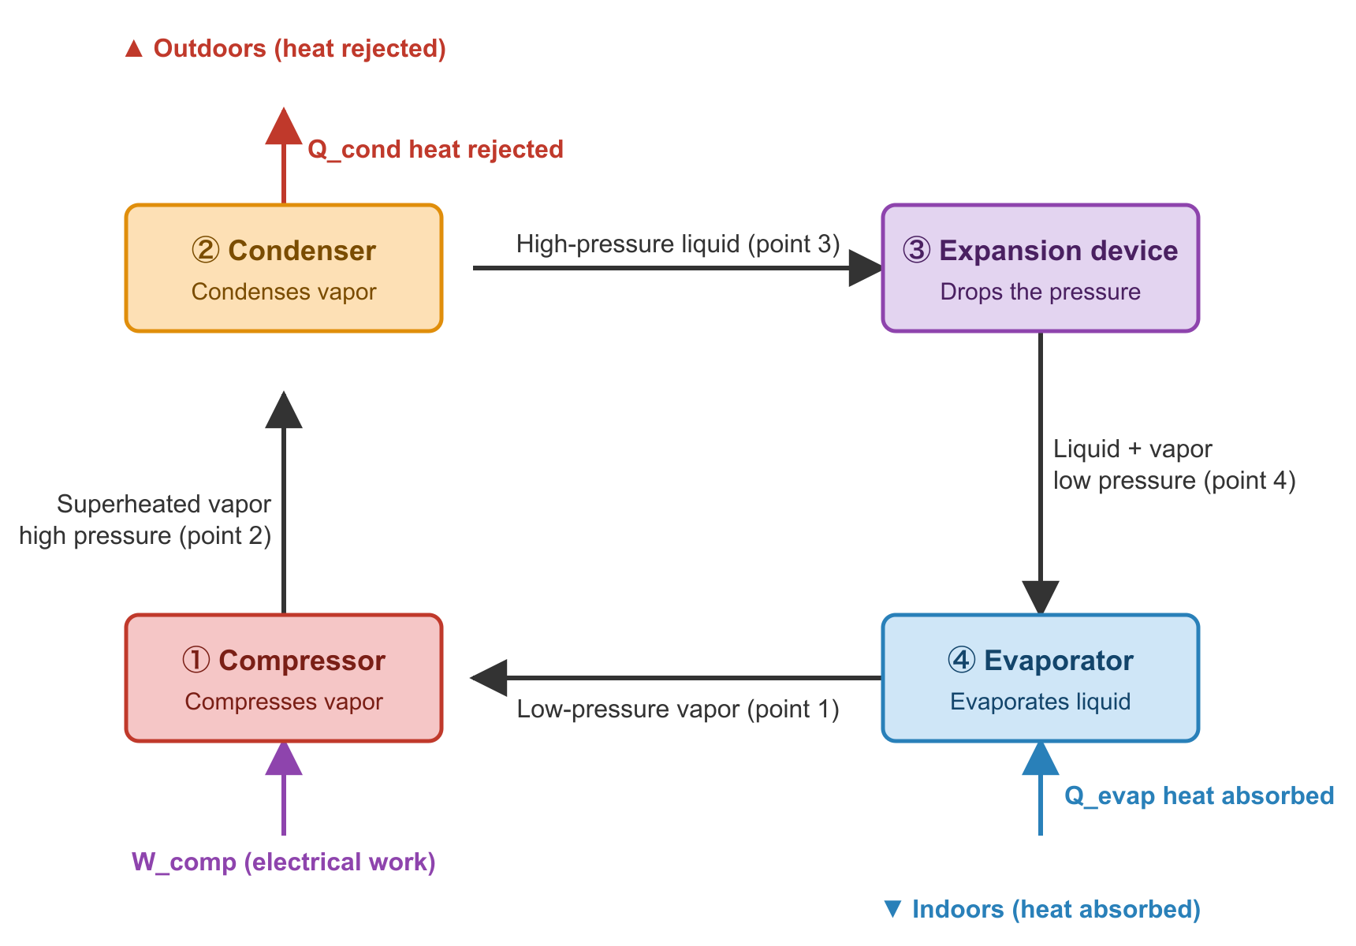
The refrigerant loop has four jobs
3
Each component changes one thing: pressure, heat, or phase.
CYCLE PATH
Trace the loop before doing equations
Compressor
1
raises pressure and saturation temperature
Condenser
2
rejects heat; vapor becomes liquid
Expansion device
3
drops pressure; liquid becomes cold mix
Four-component refrigeration loop
Air Conditioning · Chapter 1 · Topic 1.3
3

Slide 4
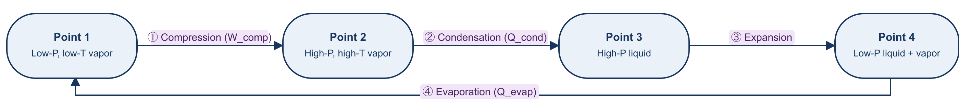
The same loop is four thermodynamic processes
4
This is the bridge from equipment to analysis.
PROCESS MAP
1→2→3→4→1 repeats continuously
1→2 Compression
1
work input; pressure rises
2→3 Condensation
2
heat out at high pressure
3→4 Expansion
3
throttle; pressure drops
Four thermodynamic processes
Air Conditioning · Chapter 1 · Topic 1.3
4

Slide 5
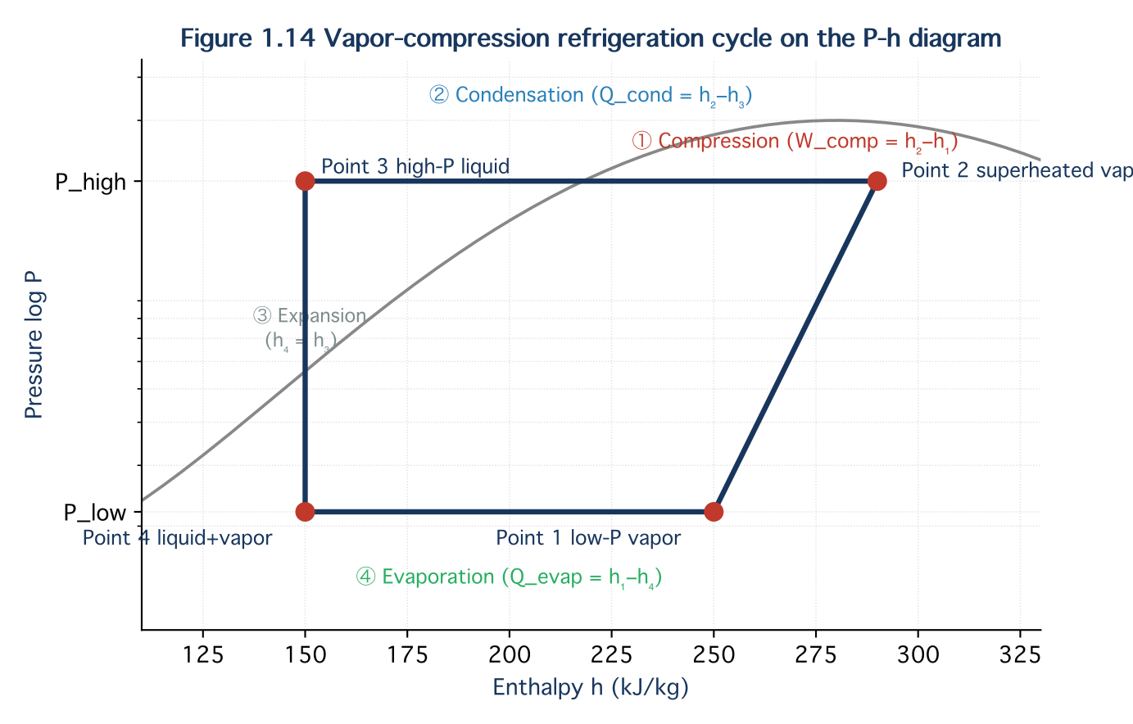
The P-h diagram turns the cycle into numbers
5
Horizontal distances become cooling, work, and heat rejection.
ANALYSIS TOOL
Read enthalpy differences, not only labels
qₑ = h₁ − h₄
1
cooling effect per kg/lb
w = h₂ − h₁
2
compressor work per kg/lb
qᶜ = h₂ − h₃
3
condenser heat rejection
Pressure–enthalpy diagram
Air Conditioning · Chapter 1 · Topic 1.3
5

Slide 6
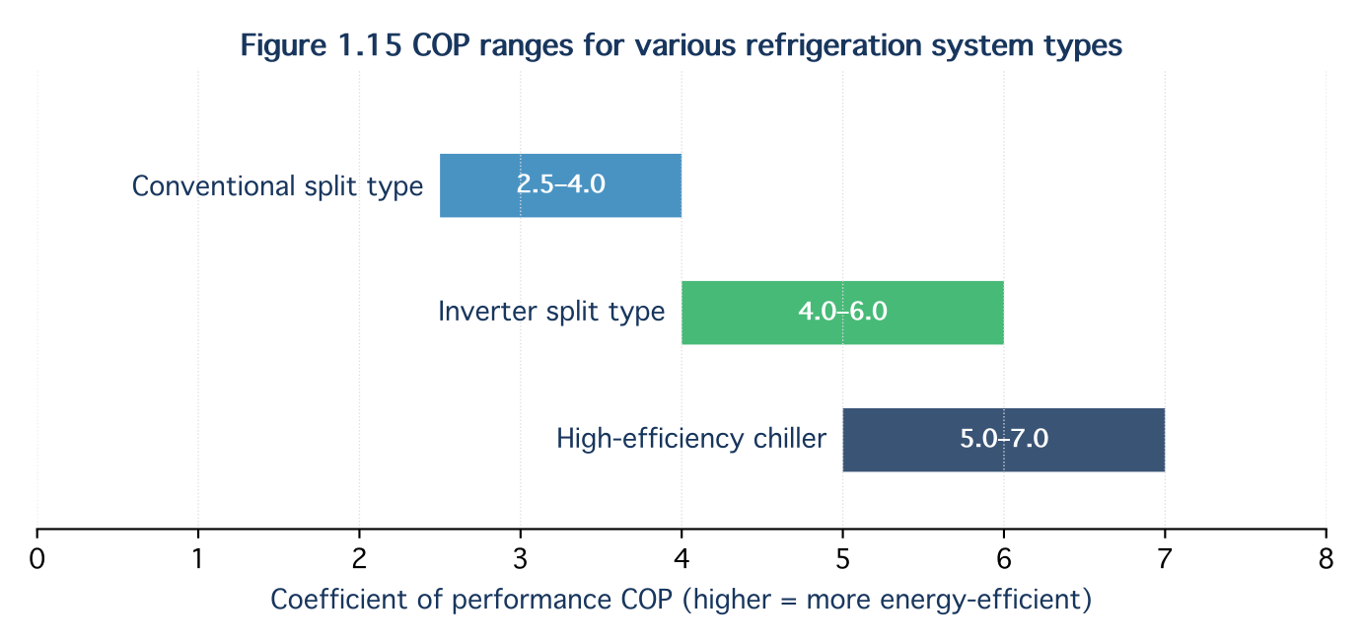
COP tells how hard the system works
6
A larger temperature lift makes the compressor work harder.
EFFICIENCY
Useful cooling divided by input work
COP
1
Q̇ cooling / Ẇ compressor
EER
2
COP × 3.412
Hot condenser
3
higher pressure ratio → lower COP
Typical COP ranges
Air Conditioning · Chapter 1 · Topic 1.3
6

Slide 7
Board example: read one cycle from a P-h diagram
7
Spend 4–5 minutes calculating with students
Step 1
Step 2
Step 3
1
2
3
read h₁, h₂, h₃, h₄
qₑ = h₁ − h₄
w = h₂ − h₁
Step 4
Step 5
Step 6
4
5
6
COP = qₑ / w
ṁ = capacity / qₑ
verify qᶜ = qₑ + w
Air Conditioning · Chapter 1 · Topic 1.3
7

Slide 8
Real cycles need safety margins
8
Subcooling improves liquid feed; superheating protects compressor
Subcooling
Benefit
Superheating
1
2
3
liquid cooler than saturation before valve
prevents flash gas and increases effect
vapor hotter than saturation before compressor
Benefit
Typical teaching range
Caution
4
5
6
prevents liquid slugging
subcool 3–8°C; superheat 6–11°C
too much margin can reduce efficiency
Air Conditioning · Chapter 1 · Topic 1.3
8

Slide 9
Troubleshooting is cycle reasoning
9
Symptoms move the state points on the diagram.
FIELD LINK
Ask: which pressure or heat transfer changed?
Indoor air
Refrigerant
Dirty condenser
1
condensing pressure rises; COP falls
heat in
Low evaporator airflow
2
coil may freeze; capacity drops
phase change carries energy
Low refrigerant charge
3
superheat rises
Field symptoms interpreted through the cycle
Air Conditioning · Chapter 1 · Topic 1.3
9

Slide 10
Pause question: afternoon outdoor temperature rises
10
Predict what changes before revealing the answer
Condensing temperature
Compressor work
COP
1
2
3
increases because heat rejection is harder
increases due to pressure ratio
decreases for the same cooling load
Design response
4
increase airflow/coil area or improve heat sink
Air Conditioning · Chapter 1 · Topic 1.3
10

Slide 11
Topic 1.3 — what students should remember
11
1
2
3
Phase change moves heat
P-h diagram quantifies the loop
Field problems shift the cycle
evaporation absorbs; condensation rejects
read qₑ, w, qᶜ, mass flow, and COP
superheat/subcooling and pressures reveal what changed
Air Conditioning · Chapter 1 · Topic 1.3
11

